Slide 1
Agent-Based Modeling of the Ductal Structure in Pancreatic Precancer
Cameron Yeagle
Advisors: Dr. Daniel Bergman

Slide 2
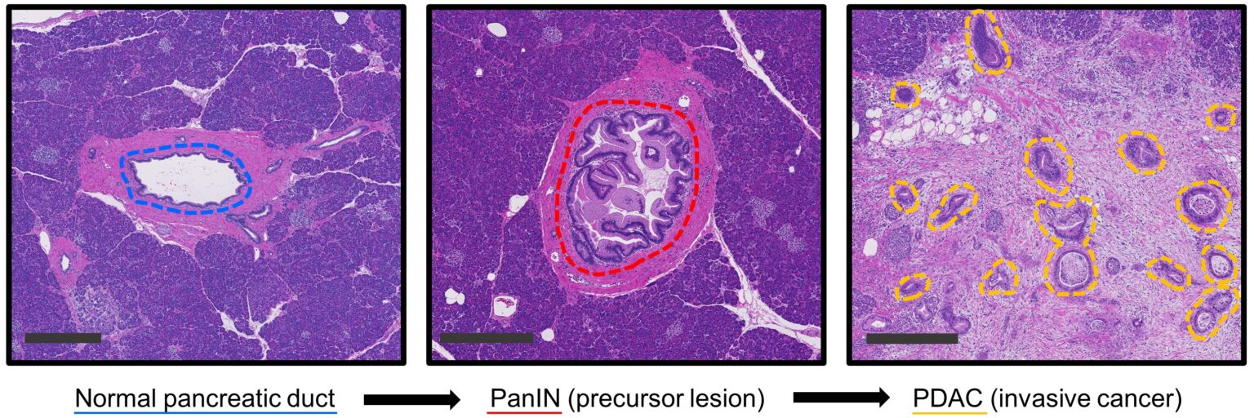
Project Goal: Model Ductal Structure
Model the evolution of the pancreatic ducts
Kiemen A, Wood LD, et al. Sci Adv. 2024
DOI: https://doi.org/10.1126/sciadv.ado5103.
Kiemen A, Wu PH, Braxton AM, Cornish TC, Hruban RH, Wood LD, et al. Power‑law growth models explain incidences and sizes of pancreatic cancer precursor lesions and confirm spatial genomic findings. Sci Adv. 2024 Jul 26;10(30):eado5103. DOI: https://doi.org/10.1126/sciadv.ado5103.
Notes:
Before developing into PDAC, the pancreatic ducts evolve into precancerous lesions (most commonly PanINs). In principle, detecting these lesions early allows for the opportunity for therapeutic intervention. However, these lesions common in the aging pancreas, with only a small subset progressing into PDAC. Hence, understanding the specific alterations in the precancer development is important (this could be better).
In PanINs, ductal epithelial cells undergo unregulated proliferation, forming papillary like structures lumen of the duct.
So for this project, the question we wanted ask was can we model this evolution of the pancreatic ducts prior to it’s develop into PDAC. This would allow us to better understand which lesions or cellular environments promote the progression to cancer.

Slide 3
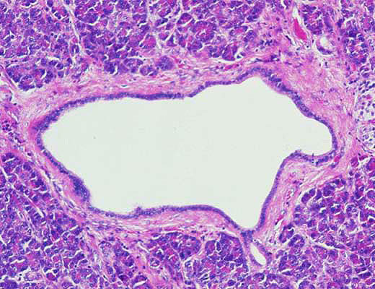
Modeling
Membrane is a dynamic structure
Build cell-membrane interactions
Hruban RH, et al. Am J Surg Pathol, 2001
Notes:
Imagine you have point in the middle of the duct. The membrane of the duct would be pulling the cell towards it, because that force is what keeps the epithelial cells lining the duct. But the duct cell would also be pulling on the duct, which creates the column like structure we see in PanINs.

Slide 4
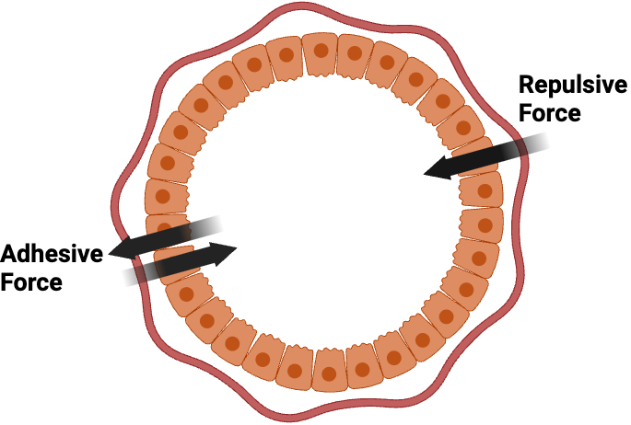
Model Mechanics
Model includes 3 main forces
Each force represents a unique ductal mechanic
Notes:
Pancreatic Ductal Adenocarcinoma is the most common subtype of pancreatic cancer, constituting about 90% of all pancreatic cancer. PDAC is the third leading cause of cancer-related deaths in the U.S., with a 5-year survival rate of only 13.3%. It is also known to have extremely poor prognosis, with nearly 90% of tumors already metastasized at diagnosis.
Force on Cell, Force on membrane instead of current labels
Pull Cell, Pull membrane
Consider adding spring in illustration

Slide 5
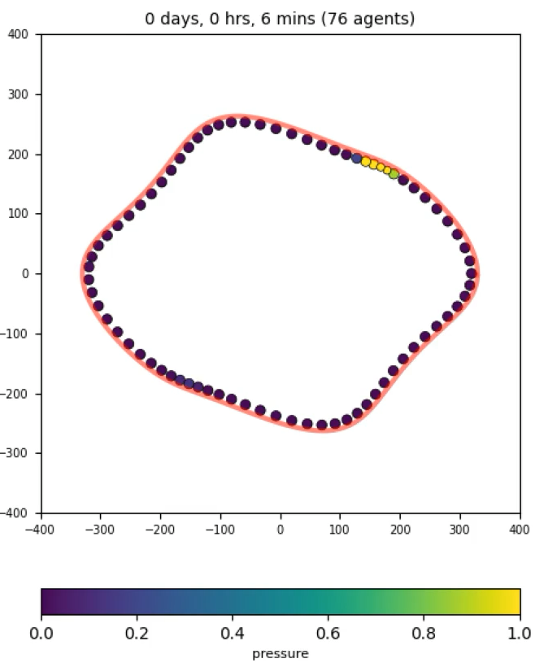
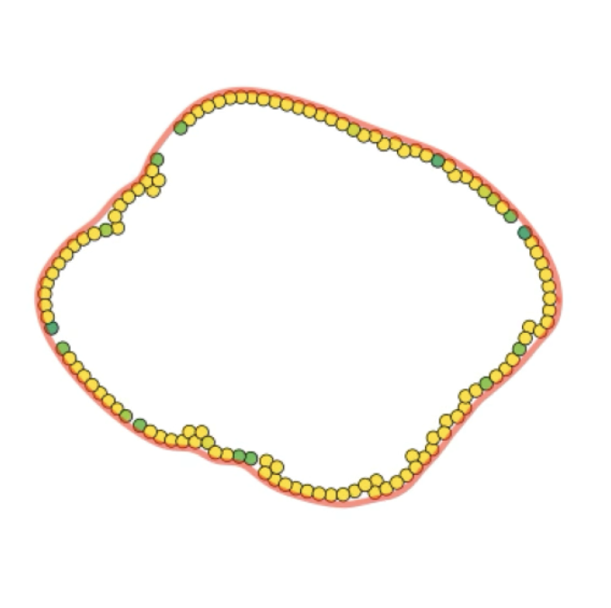
Baseline: Epithelial Proliferation
All forces enabled
Parallel cell division enabled
Notes:
Pancreatic Ductal Adenocarcinoma is the most common subtype of pancreatic cancer, constituting about 90% of all pancreatic cancer. PDAC is the third leading cause of cancer-related deaths in the U.S., with a 5-year survival rate of only 13.3%. It is also known to have extremely poor prognosis, with nearly 90% of tumors already metastasized at diagnosis.
PDAC begins in the epithelial cells lining the pancreatic ducts, which are normally responsible for regulating secretion of digestive enzymes into the small intestine. In PDAC, these cells acquire mutations that cause them to proliferate uncontrollably and eventually rupture the ductal membrane. After spreading into the stroma, cancer-associated fibroblasts develop dense networks of collogen fibers, known as desmoplasia, around the previous pancreatic ducts. This creates almost like a shield around the tumor, protecting it from immune attack and drug penetration.
Pancreatic ductal adenocarcinoma is the most common subtype of pancreatic cancer, with a 5 year survival rate of only 13%. The low survival rate is thought to be due to multiple challenges to treatment such as the difficulty of detecting PDAC before it has metastasized. (add graphic) A hallmark of PDAC is what’s called a “desmoplastic” tumor microenvironment. Compared to healthy tissue on the left, PDAC on the right has masses of cell growth in places that used to be healthy ducts, and is infiltrated by a greater diversity of immune and stromal cells while being crisscrossed and encapsulated in this network of collagen fibers, which are deposited by cancer-associated fibroblasts. The dense fibrotic network of collagen is referred to as desmoplasia and is seen in certain types of tumors.
Those immune cells that are found in this microenvironment are often suppressive such as T regulatory cells and suppressive macrophages. Some of the immune cells are “residents” that were probably there in the healthy tissue, but others are recruited from the periphery (BM+blood)

Slide 6
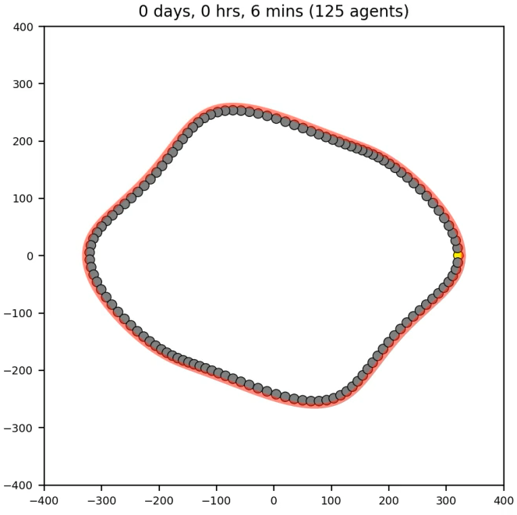
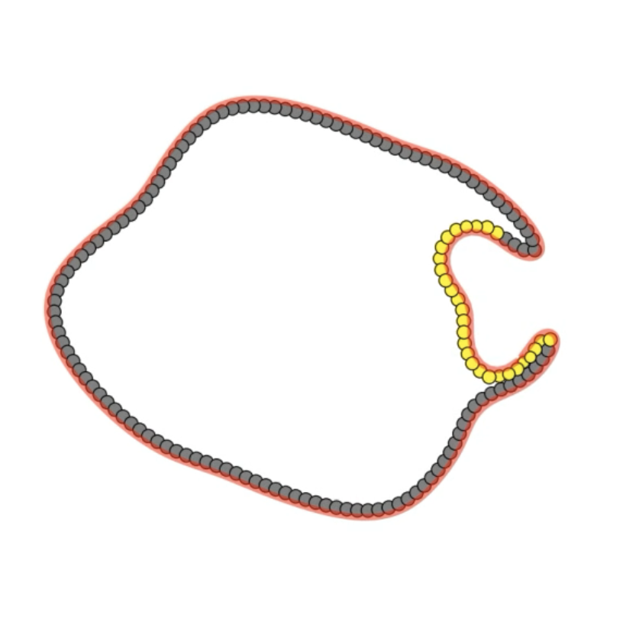
Baseline: Epithelial Proliferation
All forces enabled
Parallel cell division enabled
Notes:
Pancreatic Ductal Adenocarcinoma is the most common subtype of pancreatic cancer, constituting about 90% of all pancreatic cancer. PDAC is the third leading cause of cancer-related deaths in the U.S., with a 5-year survival rate of only 13.3%. It is also known to have extremely poor prognosis, with nearly 90% of tumors already metastasized at diagnosis.
PDAC begins in the epithelial cells lining the pancreatic ducts, which are normally responsible for regulating secretion of digestive enzymes into the small intestine. In PDAC, these cells acquire mutations that cause them to proliferate uncontrollably and eventually rupture the ductal membrane. After spreading into the stroma, cancer-associated fibroblasts develop dense networks of collogen fibers, known as desmoplasia, around the previous pancreatic ducts. This creates almost like a shield around the tumor, protecting it from immune attack and drug penetration.
Pancreatic ductal adenocarcinoma is the most common subtype of pancreatic cancer, with a 5 year survival rate of only 13%. The low survival rate is thought to be due to multiple challenges to treatment such as the difficulty of detecting PDAC before it has metastasized. (add graphic) A hallmark of PDAC is what’s called a “desmoplastic” tumor microenvironment. Compared to healthy tissue on the left, PDAC on the right has masses of cell growth in places that used to be healthy ducts, and is infiltrated by a greater diversity of immune and stromal cells while being crisscrossed and encapsulated in this network of collagen fibers, which are deposited by cancer-associated fibroblasts. The dense fibrotic network of collagen is referred to as desmoplasia and is seen in certain types of tumors.
Those immune cells that are found in this microenvironment are often suppressive such as T regulatory cells and suppressive macrophages. Some of the immune cells are “residents” that were probably there in the healthy tissue, but others are recruited from the periphery (BM+blood)

Slide 7
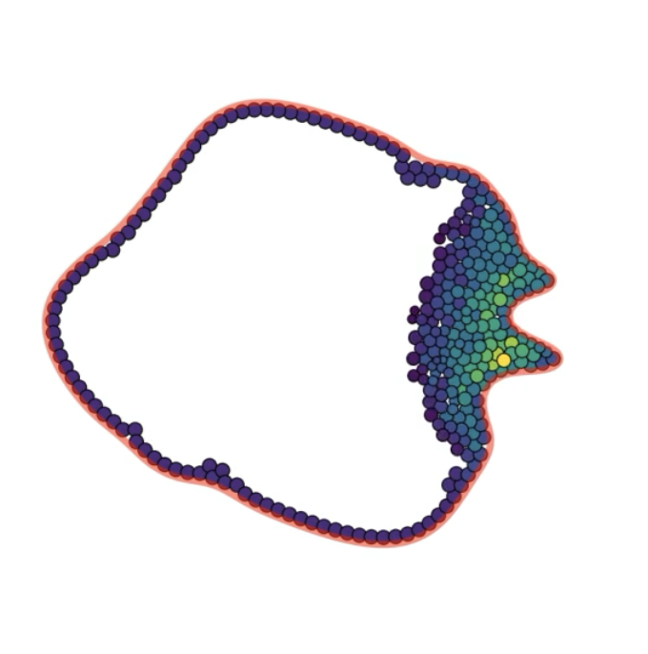
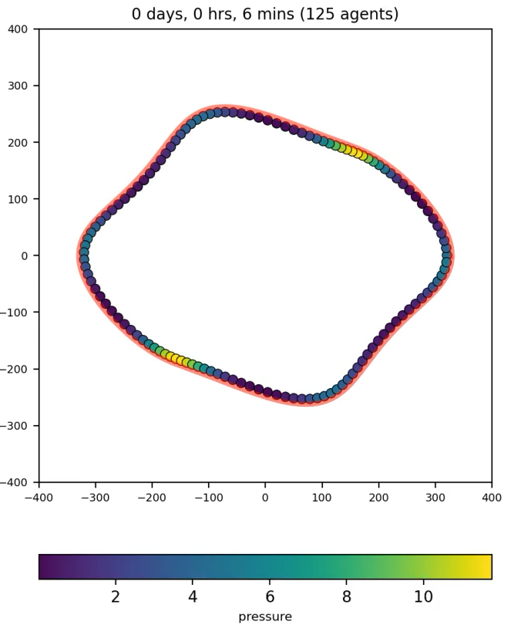
Prototype: Short Term
All forces enabled
Parallel cell division enabled
Notes:
Pancreatic Ductal Adenocarcinoma is the most common subtype of pancreatic cancer, constituting about 90% of all pancreatic cancer. PDAC is the third leading cause of cancer-related deaths in the U.S., with a 5-year survival rate of only 13.3%. It is also known to have extremely poor prognosis, with nearly 90% of tumors already metastasized at diagnosis.
PDAC begins in the epithelial cells lining the pancreatic ducts, which are normally responsible for regulating secretion of digestive enzymes into the small intestine. In PDAC, these cells acquire mutations that cause them to proliferate uncontrollably and eventually rupture the ductal membrane. After spreading into the stroma, cancer-associated fibroblasts develop dense networks of collogen fibers, known as desmoplasia, around the previous pancreatic ducts. This creates almost like a shield around the tumor, protecting it from immune attack and drug penetration.
Pancreatic ductal adenocarcinoma is the most common subtype of pancreatic cancer, with a 5 year survival rate of only 13%. The low survival rate is thought to be due to multiple challenges to treatment such as the difficulty of detecting PDAC before it has metastasized. (add graphic) A hallmark of PDAC is what’s called a “desmoplastic” tumor microenvironment. Compared to healthy tissue on the left, PDAC on the right has masses of cell growth in places that used to be healthy ducts, and is infiltrated by a greater diversity of immune and stromal cells while being crisscrossed and encapsulated in this network of collagen fibers, which are deposited by cancer-associated fibroblasts. The dense fibrotic network of collagen is referred to as desmoplasia and is seen in certain types of tumors.
Those immune cells that are found in this microenvironment are often suppressive such as T regulatory cells and suppressive macrophages. Some of the immune cells are “residents” that were probably there in the healthy tissue, but others are recruited from the periphery (BM+blood)

Slide 8

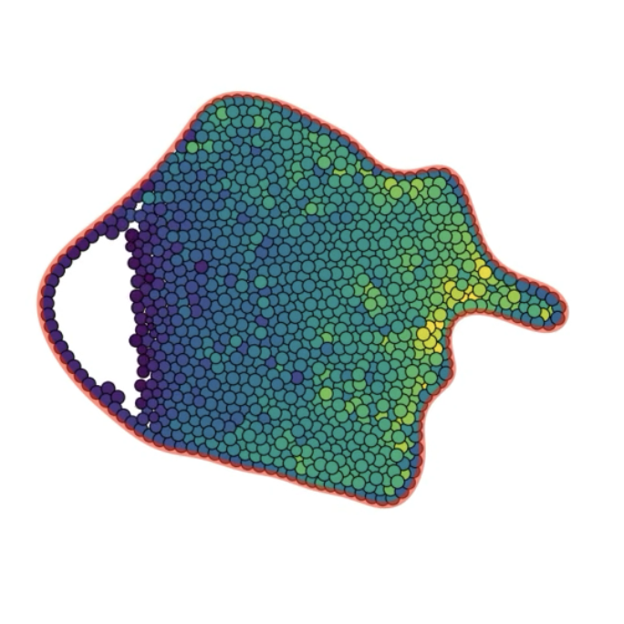
Prototype: Long Term
Notes:
Pancreatic Ductal Adenocarcinoma is the most common subtype of pancreatic cancer, constituting about 90% of all pancreatic cancer. PDAC is the third leading cause of cancer-related deaths in the U.S., with a 5-year survival rate of only 13.3%. It is also known to have extremely poor prognosis, with nearly 90% of tumors already metastasized at diagnosis.
PDAC begins in the epithelial cells lining the pancreatic ducts, which are normally responsible for regulating secretion of digestive enzymes into the small intestine. In PDAC, these cells acquire mutations that cause them to proliferate uncontrollably and eventually rupture the ductal membrane. After spreading into the stroma, cancer-associated fibroblasts develop dense networks of collogen fibers, known as desmoplasia, around the previous pancreatic ducts. This creates almost like a shield around the tumor, protecting it from immune attack and drug penetration.
Pancreatic ductal adenocarcinoma is the most common subtype of pancreatic cancer, with a 5 year survival rate of only 13%. The low survival rate is thought to be due to multiple challenges to treatment such as the difficulty of detecting PDAC before it has metastasized. (add graphic) A hallmark of PDAC is what’s called a “desmoplastic” tumor microenvironment. Compared to healthy tissue on the left, PDAC on the right has masses of cell growth in places that used to be healthy ducts, and is infiltrated by a greater diversity of immune and stromal cells while being crisscrossed and encapsulated in this network of collagen fibers, which are deposited by cancer-associated fibroblasts. The dense fibrotic network of collagen is referred to as desmoplasia and is seen in certain types of tumors.
Those immune cells that are found in this microenvironment are often suppressive such as T regulatory cells and suppressive macrophages. Some of the immune cells are “residents” that were probably there in the healthy tissue, but others are recruited from the periphery (BM+blood)

Slide 9
Where We Are Heading
Main Ideas:
Resolve Long Term Instability
ECM Supporting Force
Cellular Extrusion Through Membrane
Cells undergoing EMT
Representation of Mucin in Lumen
Notes:
Pancreatic Ductal Adenocarcinoma is the most common subtype of pancreatic cancer, constituting about 90% of all pancreatic cancer. PDAC is the third leading cause of cancer-related deaths in the U.S., with a 5-year survival rate of only 13.3%. It is also known to have extremely poor prognosis, with nearly 90% of tumors already metastasized at diagnosis.
PDAC begins in the epithelial cells lining the pancreatic ducts, which are normally responsible for regulating secretion of digestive enzymes into the small intestine. In PDAC, these cells acquire mutations that cause them to proliferate uncontrollably and eventually rupture the ductal membrane. After spreading into the stroma, cancer-associated fibroblasts develop dense networks of collogen fibers, known as desmoplasia, around the previous pancreatic ducts. This creates almost like a shield around the tumor, protecting it from immune attack and drug penetration.
Pancreatic ductal adenocarcinoma is the most common subtype of pancreatic cancer, with a 5 year survival rate of only 13%. The low survival rate is thought to be due to multiple challenges to treatment such as the difficulty of detecting PDAC before it has metastasized. (add graphic) A hallmark of PDAC is what’s called a “desmoplastic” tumor microenvironment. Compared to healthy tissue on the left, PDAC on the right has masses of cell growth in places that used to be healthy ducts, and is infiltrated by a greater diversity of immune and stromal cells while being crisscrossed and encapsulated in this network of collagen fibers, which are deposited by cancer-associated fibroblasts. The dense fibrotic network of collagen is referred to as desmoplasia and is seen in certain types of tumors.
Those immune cells that are found in this microenvironment are often suppressive such as T regulatory cells and suppressive macrophages. Some of the immune cells are “residents” that were probably there in the healthy tissue, but others are recruited from the periphery (BM+blood)

Slide 10
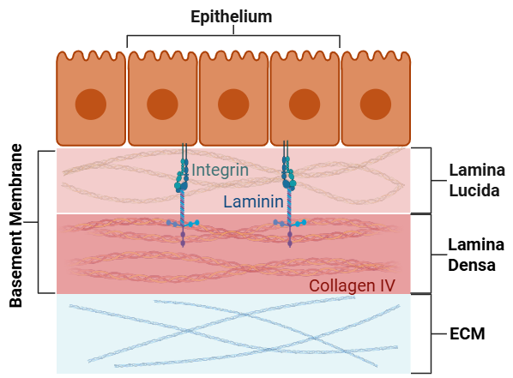
Background: Cell Pulling Force
BM is made up of Laminin and Collagen IV [1]
Laminin binds to Integrin proteins
[1] Yurchenco PD, Patton BL. Curr Pharm Des. 2009;15(12):1277-94. doi: 10.2174/138161209787846766
Notes:
Laminins are glycoproteins that act as scaffolding for the basement membrane.
Collogen IV is the sheet-like network that provides tensile strength to the basement membrane.
Epithelial cells are polarized, meaning they have an apical (facing the lumen) and a basal side (facing the BM). This basal side expresses integrins and other receptors that lock the cells to the membrane.
Integrins are transmembrane receptors that lamanin binds to.

Slide 11
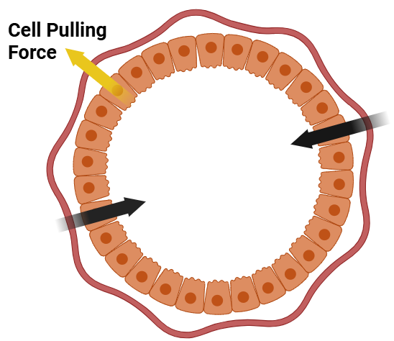

Cell Pulling Force
[1] Yurchenco PD, Patton BL. Developmental and pathogenic mechanisms of basement membrane assembly. Curr Pharm Des. 2009;15(12):1277-94. doi: 10.2174/138161209787846766. PMID: 19355968; PMCID: PMC2978668.
Represented by a Spring Force (Hooke’s Law)
$$F=−kx$$
Notes:
Pancreatic Ductal Adenocarcinoma is the most common subtype of pancreatic cancer, constituting about 90% of all pancreatic cancer. PDAC is the third leading cause of cancer-related deaths in the U.S., with a 5-year survival rate of only 13.3%. It is also known to have extremely poor prognosis, with nearly 90% of tumors already metastasized at diagnosis.

Slide 12
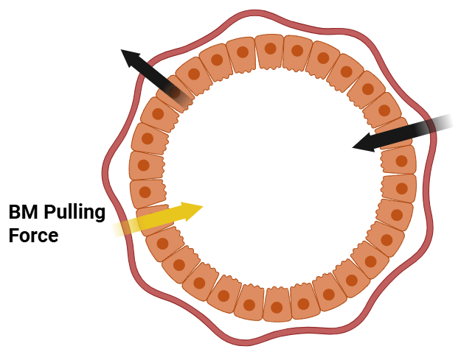
Background: BM Pulling Force
BM has elastic properties [2]
Elasticity is non-linear [3]
More deformation requires more force
[2] Guerra Santillán KY, Dahmann C, Fischer-Friedrich E. Elastic Contractile Stress in the Basement Membrane Generates Basal Tension in Epithelia. PRX Life. 2024;2(1):013004. doi:10.1103/PRXLife.2.013004
[3] H. Li, Y. Zheng, Y.L. Han, S. Cai, & M. Guo, Nonlinear elasticity of biological basement membrane revealed by rapid inflation and deflation, Proc. Natl. Acad. Sci. U.S.A. 118 (11) e2022422118, https://doi.org/10.1073/pnas.2022422118 (2021).
[3] H. Li, et al. Proc. Natl. Acad. Sci. U.S.A.
[2] Guerra Santillán KY, et al. PRX Life. 2024. doi:10.1103/PRXLife.2.013004
[3] H. Li, et al. Proc. Natl. Acad. Sci. U.S.A.

Slide 13


Gaussian Kernel
Calculate each node’s weight:
$$w_{i}=\exp\left(−\frac{{\left\|b_{i} − p\right\|}^{2}}{\left(2σ^{2}\right)}\right)$$
Where $b_{i},p∈ℝ^{3}.$ Here $b_{i }$are nodes nearby node $p.$
$$W_{i}=\left(\frac{w_{i}}{\sum_{j}{w_{j}}}\right)$$
Notes:
This is the standard Gaussian function, and it ensures that closer points get a much higher weight than distant points.
Next, to ensure we are only distributing the force, not changing its overall magnitude, we need the weights to sum to 1. So, we take each individual weight and divide it by the sum of all the weights.“
"Finally, we apply the force. The force vector applied to each individual membrane node is simply the total force from the cell multiplied by that node's normalized weight.“
"The code does this by adding this fraction of the force to an accumulator for each node, which is then used to update the membrane's position at the end of the time step."
Diagram of a couple cells with a gaussian bell curve to wrap the concept together.

Slide 14
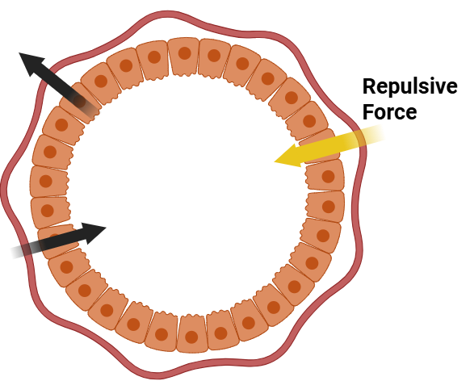
Repulsive Force
BM serves as a physical barrier
Rupturing of BM is hallmark of PDAC development (future work)
Notes:
Include discussion of dead zone for cell equilibrium.
Simulation that shows this repulsive force keeps the cells from moving through the membrane.
Discuss if the repulsive force will cause the membrane to deform and bend.

Slide 15
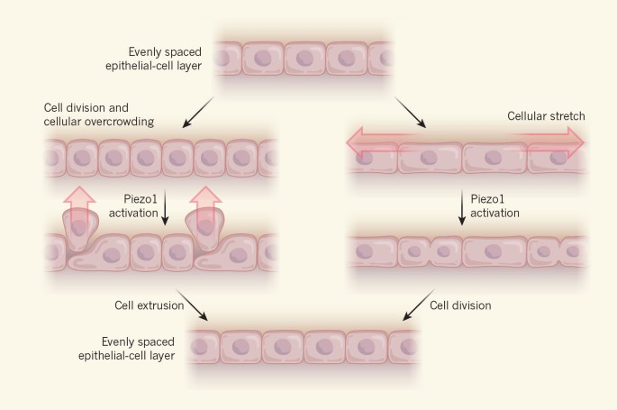
Epithelial Cell Division
Heisenberg, CP. Stretched divisions. Nature 543, 43–44 (2017).
Notes:
force-sensitive ion-channel protein Piezo1. Detects physical forces like pressure and stretch.

Slide 16
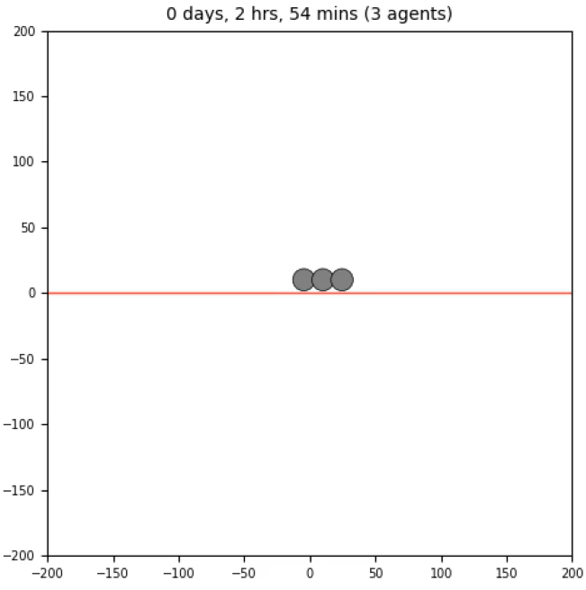
Parallel Cell Division: Stretching
Simulation showing cellular stretching
Requires cell division parallel to membrane
Notes:
Show diagram of this parallel cell division concept.
Show simulation with just 3 cells and proliferation.
Fast proliferation rate and rule where time decreases cycle entry. Flat line

Slide 17
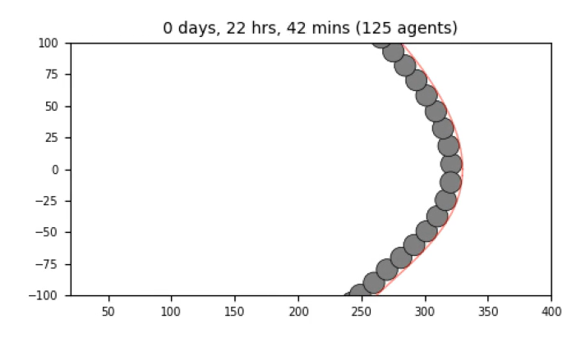
Parallel Cell Division: Crowding
Notes:
Show diagram of this parallel cell division concept.
Show simulation with just 3 cells and proliferation.
Fast proliferation rate and rule where time decreases cycle entry. Flat line

Slide 18
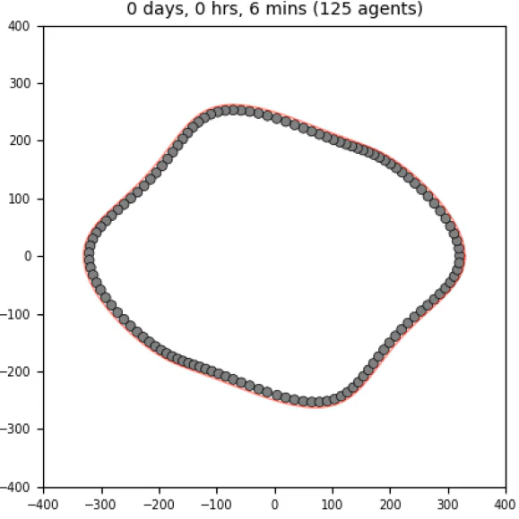
Malignant Cell Simulation
All forces enabled
Parallel cell division enabled
Notes:
Pancreatic Ductal Adenocarcinoma is the most common subtype of pancreatic cancer, constituting about 90% of all pancreatic cancer. PDAC is the third leading cause of cancer-related deaths in the U.S., with a 5-year survival rate of only 13.3%. It is also known to have extremely poor prognosis, with nearly 90% of tumors already metastasized at diagnosis.
PDAC begins in the epithelial cells lining the pancreatic ducts, which are normally responsible for regulating secretion of digestive enzymes into the small intestine. In PDAC, these cells acquire mutations that cause them to proliferate uncontrollably and eventually rupture the ductal membrane. After spreading into the stroma, cancer-associated fibroblasts develop dense networks of collogen fibers, known as desmoplasia, around the previous pancreatic ducts. This creates almost like a shield around the tumor, protecting it from immune attack and drug penetration.
Pancreatic ductal adenocarcinoma is the most common subtype of pancreatic cancer, with a 5 year survival rate of only 13%. The low survival rate is thought to be due to multiple challenges to treatment such as the difficulty of detecting PDAC before it has metastasized. (add graphic) A hallmark of PDAC is what’s called a “desmoplastic” tumor microenvironment. Compared to healthy tissue on the left, PDAC on the right has masses of cell growth in places that used to be healthy ducts, and is infiltrated by a greater diversity of immune and stromal cells while being crisscrossed and encapsulated in this network of collagen fibers, which are deposited by cancer-associated fibroblasts. The dense fibrotic network of collagen is referred to as desmoplasia and is seen in certain types of tumors.
Those immune cells that are found in this microenvironment are often suppressive such as T regulatory cells and suppressive macrophages. Some of the immune cells are “residents” that were probably there in the healthy tissue, but others are recruited from the periphery (BM+blood)

Slide 19
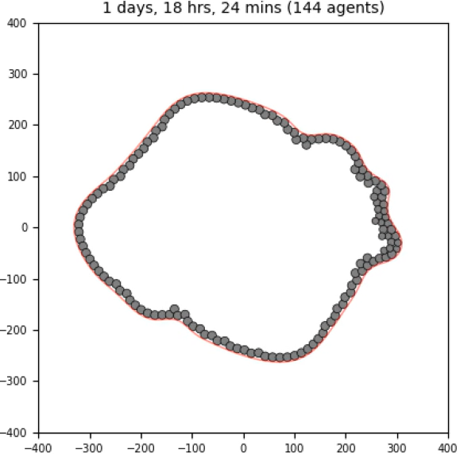
Malignant Cell Simulation
Notes:
Pancreatic Ductal Adenocarcinoma is the most common subtype of pancreatic cancer, constituting about 90% of all pancreatic cancer. PDAC is the third leading cause of cancer-related deaths in the U.S., with a 5-year survival rate of only 13.3%. It is also known to have extremely poor prognosis, with nearly 90% of tumors already metastasized at diagnosis.
PDAC begins in the epithelial cells lining the pancreatic ducts, which are normally responsible for regulating secretion of digestive enzymes into the small intestine. In PDAC, these cells acquire mutations that cause them to proliferate uncontrollably and eventually rupture the ductal membrane. After spreading into the stroma, cancer-associated fibroblasts develop dense networks of collogen fibers, known as desmoplasia, around the previous pancreatic ducts. This creates almost like a shield around the tumor, protecting it from immune attack and drug penetration.
Pancreatic ductal adenocarcinoma is the most common subtype of pancreatic cancer, with a 5 year survival rate of only 13%. The low survival rate is thought to be due to multiple challenges to treatment such as the difficulty of detecting PDAC before it has metastasized. (add graphic) A hallmark of PDAC is what’s called a “desmoplastic” tumor microenvironment. Compared to healthy tissue on the left, PDAC on the right has masses of cell growth in places that used to be healthy ducts, and is infiltrated by a greater diversity of immune and stromal cells while being crisscrossed and encapsulated in this network of collagen fibers, which are deposited by cancer-associated fibroblasts. The dense fibrotic network of collagen is referred to as desmoplasia and is seen in certain types of tumors.
Those immune cells that are found in this microenvironment are often suppressive such as T regulatory cells and suppressive macrophages. Some of the immune cells are “residents” that were probably there in the healthy tissue, but others are recruited from the periphery (BM+blood)

Slide 20
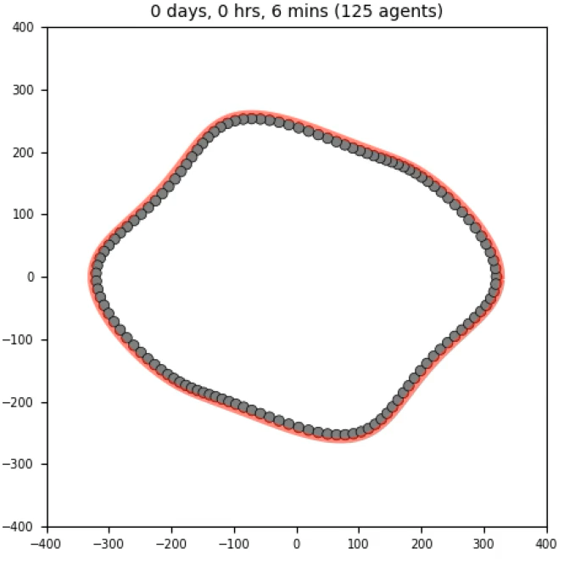

Full Test 1:
Baseline
Just Restoring
Notes:
Pancreatic Ductal Adenocarcinoma is the most common subtype of pancreatic cancer, constituting about 90% of all pancreatic cancer. PDAC is the third leading cause of cancer-related deaths in the U.S., with a 5-year survival rate of only 13.3%. It is also known to have extremely poor prognosis, with nearly 90% of tumors already metastasized at diagnosis.
PDAC begins in the epithelial cells lining the pancreatic ducts, which are normally responsible for regulating secretion of digestive enzymes into the small intestine. In PDAC, these cells acquire mutations that cause them to proliferate uncontrollably and eventually rupture the ductal membrane. After spreading into the stroma, cancer-associated fibroblasts develop dense networks of collogen fibers, known as desmoplasia, around the previous pancreatic ducts. This creates almost like a shield around the tumor, protecting it from immune attack and drug penetration.
Pancreatic ductal adenocarcinoma is the most common subtype of pancreatic cancer, with a 5 year survival rate of only 13%. The low survival rate is thought to be due to multiple challenges to treatment such as the difficulty of detecting PDAC before it has metastasized. (add graphic) A hallmark of PDAC is what’s called a “desmoplastic” tumor microenvironment. Compared to healthy tissue on the left, PDAC on the right has masses of cell growth in places that used to be healthy ducts, and is infiltrated by a greater diversity of immune and stromal cells while being crisscrossed and encapsulated in this network of collagen fibers, which are deposited by cancer-associated fibroblasts. The dense fibrotic network of collagen is referred to as desmoplasia and is seen in certain types of tumors.
Those immune cells that are found in this microenvironment are often suppressive such as T regulatory cells and suppressive macrophages. Some of the immune cells are “residents” that were probably there in the healthy tissue, but others are recruited from the periphery (BM+blood)

Slide 21
Future Work: Discussion
Refine fibroblast interactions
Fibroblasts, Macrophages, etc
MMP Enzymes
Would love suggestions for next steps?
Notes:
Pancreatic Ductal Adenocarcinoma is the most common subtype of pancreatic cancer, constituting about 90% of all pancreatic cancer. PDAC is the third leading cause of cancer-related deaths in the U.S., with a 5-year survival rate of only 13.3%. It is also known to have extremely poor prognosis, with nearly 90% of tumors already metastasized at diagnosis.
PDAC begins in the epithelial cells lining the pancreatic ducts, which are normally responsible for regulating secretion of digestive enzymes into the small intestine. In PDAC, these cells acquire mutations that cause them to proliferate uncontrollably and eventually rupture the ductal membrane. After spreading into the stroma, cancer-associated fibroblasts develop dense networks of collogen fibers, known as desmoplasia, around the previous pancreatic ducts. This creates almost like a shield around the tumor, protecting it from immune attack and drug penetration.
Pancreatic ductal adenocarcinoma is the most common subtype of pancreatic cancer, with a 5 year survival rate of only 13%. The low survival rate is thought to be due to multiple challenges to treatment such as the difficulty of detecting PDAC before it has metastasized. (add graphic) A hallmark of PDAC is what’s called a “desmoplastic” tumor microenvironment. Compared to healthy tissue on the left, PDAC on the right has masses of cell growth in places that used to be healthy ducts, and is infiltrated by a greater diversity of immune and stromal cells while being crisscrossed and encapsulated in this network of collagen fibers, which are deposited by cancer-associated fibroblasts. The dense fibrotic network of collagen is referred to as desmoplasia and is seen in certain types of tumors.
Those immune cells that are found in this microenvironment are often suppressive such as T regulatory cells and suppressive macrophages. Some of the immune cells are “residents” that were probably there in the healthy tissue, but others are recruited from the periphery (BM+blood)

Slide 22
Acknowledgements
Thank you everyone for the support!
Bergman Lab
Fertig Lab
Macklin Lab

Slide 23
Thank you!
Any Questions?

Slide 24
Citations
[1] Yurchenco PD, Patton BL. Developmental and pathogenic mechanisms of basement membrane assembly. Curr Pharm Des. 2009;15(12):1277-94. doi: 10.2174/138161209787846766. PMID: 19355968; PMCID: PMC2978668.
[2] Guerra Santillán KY, Dahmann C, Fischer-Friedrich E. Elastic Contractile Stress in the Basement Membrane Generates Basal Tension in Epithelia. PRX Life. 2024;2(1):013004. doi:10.1103/PRXLife.2.013004
[3] H. Li, Y. Zheng, Y.L. Han, S. Cai, & M. Guo, Nonlinear elasticity of biological basement membrane revealed by rapid inflation and deflation, Proc. Natl. Acad. Sci. U.S.A. 118 (11) e2022422118, https://doi.org/10.1073/pnas.2022422118 (2021).
[4] Schneiderhan W, Korpal M, Hinz J, et al. Pancreatic stellate cells are an important source of MMP-2 in human pancreatic cancer and accelerate tumor cell invasion. Gut. 2007;56(6):823-830. doi:10.1136/gut.2006.104217
Notes:
Pancreatic Ductal Adenocarcinoma is the most common subtype of pancreatic cancer, constituting about 90% of all pancreatic cancer. PDAC is the third leading cause of cancer-related deaths in the U.S., with a 5-year survival rate of only 13.3%. It is also known to have extremely poor prognosis, with nearly 90% of tumors already metastasized at diagnosis.
PDAC begins in the epithelial cells lining the pancreatic ducts, which are normally responsible for regulating secretion of digestive enzymes into the small intestine. In PDAC, these cells acquire mutations that cause them to proliferate uncontrollably and eventually rupture the ductal membrane. After spreading into the stroma, cancer-associated fibroblasts develop dense networks of collogen fibers, known as desmoplasia, around the previous pancreatic ducts. This creates almost like a shield around the tumor, protecting it from immune attack and drug penetration.
Pancreatic ductal adenocarcinoma is the most common subtype of pancreatic cancer, with a 5 year survival rate of only 13%. The low survival rate is thought to be due to multiple challenges to treatment such as the difficulty of detecting PDAC before it has metastasized. (add graphic) A hallmark of PDAC is what’s called a “desmoplastic” tumor microenvironment. Compared to healthy tissue on the left, PDAC on the right has masses of cell growth in places that used to be healthy ducts, and is infiltrated by a greater diversity of immune and stromal cells while being crisscrossed and encapsulated in this network of collagen fibers, which are deposited by cancer-associated fibroblasts. The dense fibrotic network of collagen is referred to as desmoplasia and is seen in certain types of tumors.
Those immune cells that are found in this microenvironment are often suppressive such as T regulatory cells and suppressive macrophages. Some of the immune cells are “residents” that were probably there in the healthy tissue, but others are recruited from the periphery (BM+blood)

Slide 25
Citations
Kiemen A, Wu PH, Braxton AM, Cornish TC, Hruban RH, Wood LD, et al. Power‑law growth models explain incidences and sizes of pancreatic cancer precursor lesions and confirm spatial genomic findings. Sci Adv. 2024 Jul 26;10(30):eado5103. DOI: https://doi.org/10.1126/sciadv.ado5103.
Hruban RH, Adsay NV, Albores-Saavedra J, Compton C, Garrett E, Goodman SN, Kern SE, Klimstra DS, Kloppel G, Longnecker DS, Luttges J, Offerhaus GJA. Pancreatic intraepithelial neoplasia (PanIN): A New nomenclature and classification system for pancreatic duct lesions. Am J Surg Pathol, 2001, volume 25:579-86
A. Ghaffarizadeh, R. Heiland, S.H. Friedman, S.M. Mumenthaler, and P. Macklin, PhysiCell: an open source physics-based cell simulator for 3-D multicellular systems, PLoS Comput. Biol. 14(2): e1005991 (2018). DOI: 10.1371/journal.pcbi.1005991.
Heisenberg, CP. Stretched divisions. Nature 543, 43–44 (2017). https://doi.org/10.1038/nature21502
Notes:
Pancreatic Ductal Adenocarcinoma is the most common subtype of pancreatic cancer, constituting about 90% of all pancreatic cancer. PDAC is the third leading cause of cancer-related deaths in the U.S., with a 5-year survival rate of only 13.3%. It is also known to have extremely poor prognosis, with nearly 90% of tumors already metastasized at diagnosis.
PDAC begins in the epithelial cells lining the pancreatic ducts, which are normally responsible for regulating secretion of digestive enzymes into the small intestine. In PDAC, these cells acquire mutations that cause them to proliferate uncontrollably and eventually rupture the ductal membrane. After spreading into the stroma, cancer-associated fibroblasts develop dense networks of collogen fibers, known as desmoplasia, around the previous pancreatic ducts. This creates almost like a shield around the tumor, protecting it from immune attack and drug penetration.
Pancreatic ductal adenocarcinoma is the most common subtype of pancreatic cancer, with a 5 year survival rate of only 13%. The low survival rate is thought to be due to multiple challenges to treatment such as the difficulty of detecting PDAC before it has metastasized. (add graphic) A hallmark of PDAC is what’s called a “desmoplastic” tumor microenvironment. Compared to healthy tissue on the left, PDAC on the right has masses of cell growth in places that used to be healthy ducts, and is infiltrated by a greater diversity of immune and stromal cells while being crisscrossed and encapsulated in this network of collagen fibers, which are deposited by cancer-associated fibroblasts. The dense fibrotic network of collagen is referred to as desmoplasia and is seen in certain types of tumors.
Those immune cells that are found in this microenvironment are often suppressive such as T regulatory cells and suppressive macrophages. Some of the immune cells are “residents” that were probably there in the healthy tissue, but others are recruited from the periphery (BM+blood)

Slide 26


Level-Set Method
The ductal region Ω and the basement membrane $Γ=∂Ω$ are defined implicitly by a signed distance function $φ$,
Notes:
Imagine you have a map of the pancreatic tissue. The level-set method works by assigning a number to every single point on this map based on its location relative to the duct's boundary

Slide 27


Handling Deformations
$∀$ point $x(t)$ on $Γ, φ\left(x\left(t\right),t\right)=0$must hold for all time, i.e. $\frac{∂φ}{∂t}=0$. Hence, by the multi-variable chain rule,
$$\frac{dφ}{dt}=\frac{∂φ}{∂t}+∇φ ⋅\frac{dx}{dt}=\frac{∂φ}{∂t}+∇φ⋅V$$
Let $\tilde{V}=V⋅n,$where n is the unit normal vector $\frac{∇φ}{\left|∇φ\right|}$. Then,
$$=\frac{∂φ}{∂t}+\tilde{V}\left|∇φ\right|=0$$
Notes:
∂𝜙/∂t: This part represents how our map changes at a fixed point in time. It's the "update" to our map that we need to calculate.
V: This is the speed at which the boundary is moving at that point.
|∇𝜙|: This part represents the direction the boundary is moving (straight out, perpendicular to the shoreline).
So, the equation simply says: The rate we update our map (∂𝜙/∂t) must be equal to the negative of the speed (V) at which the boundary is moving.

